Slide 1
Driver Awareness in King County
L3 Washington Fatal Crash Survey
TEAM IC23045

Slide 2
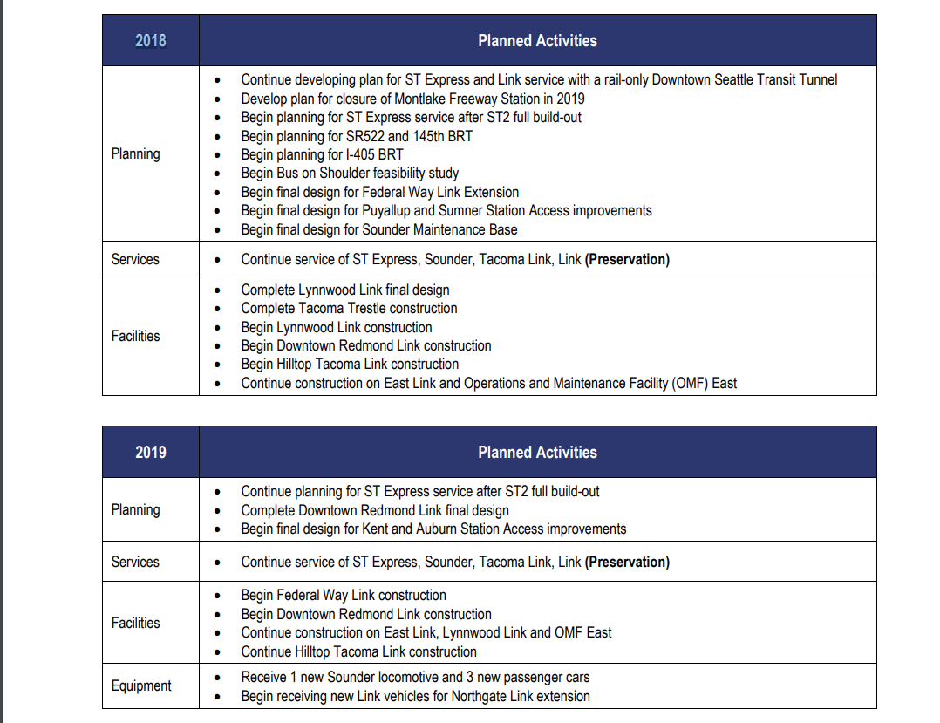
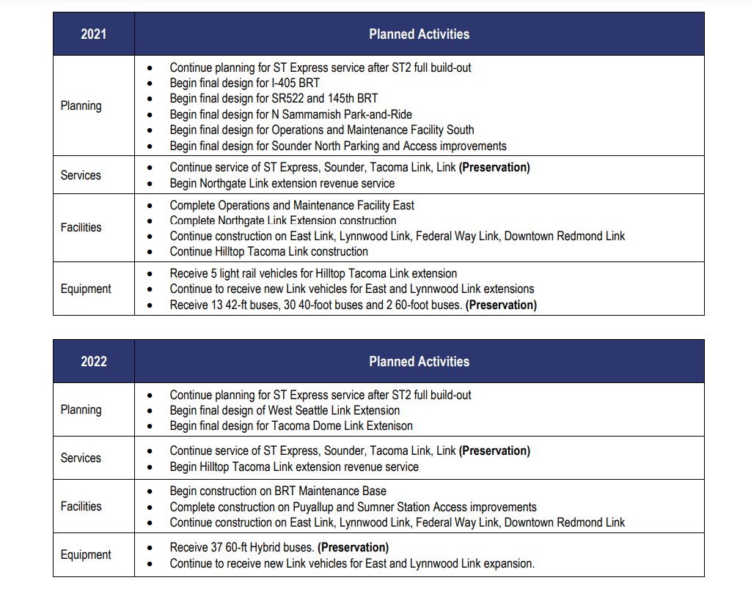
Introduction
2018 - A project for railroad expansion is introduced within the King County Area
Notes:
A light rail system has been in production in King County, Seattle since 2018. Since construction broke ground, the light rail system has moved northwards passing through some of the very zip codes that were surveyed in our data. With this information, we plan to answer the question of whether or not having a light rail system running through your zip code is beneficial for the population regarding knowledge on traffic safety laws.

Slide 3
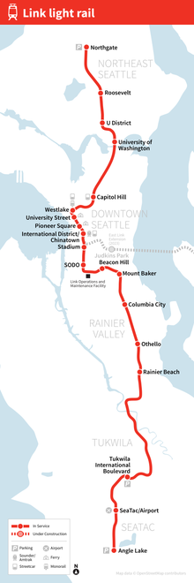
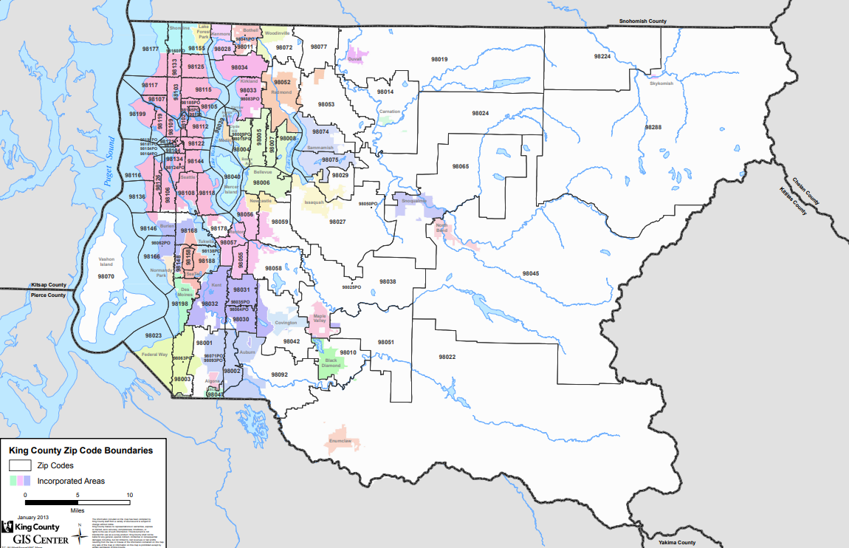
Light Rail System

Slide 4
Questions
What impact, if any, does the development of the light rail system have on the awareness of drivers in King County?
How does the understanding of these drivers compare to the rest of the county?

Slide 5
Data Preparation Steps
In order to observe this, we
Cut down csv to include only questions pertaining to legality
Research areas where the train will pass through its development
Separated the data into groups
Zip codes within area of the light rail’s development
Rest of the Zip Codes of the County
Compared information

Slide 6
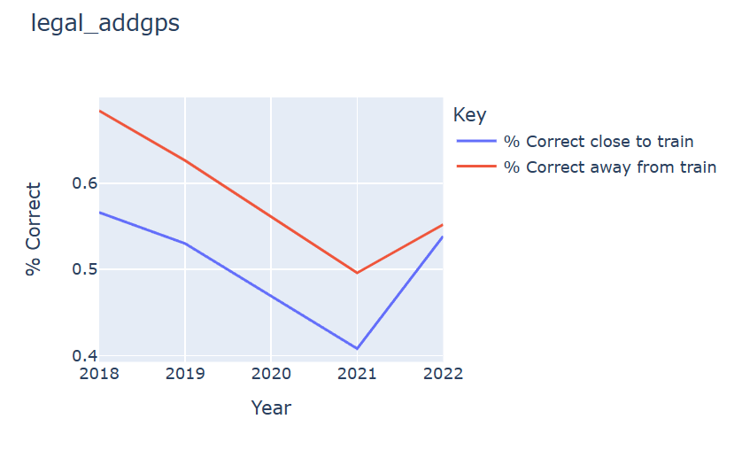
3
Is it legal to type on a GPS while driving?
Notes:
Legal_addgps = type an address into GPS while driving

Slide 7
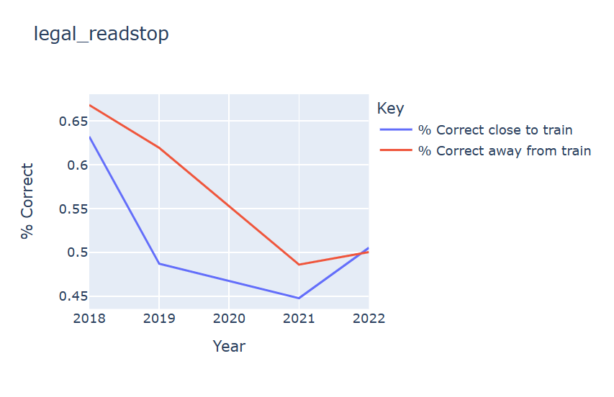
Is it legal to read your phone while stopped?
Notes:
legal _readstop = read a text message while stopped at an intersection

Slide 8
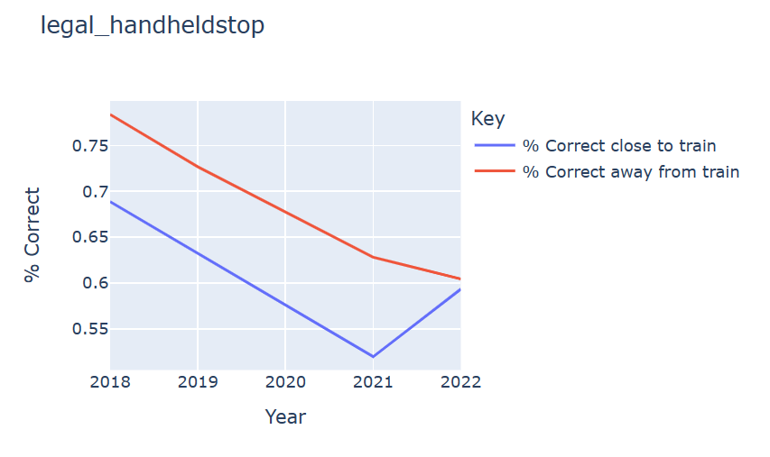
Is it legal to look at your phone while stopped?
Notes:
Legal_handheldstop = talk on a hand-held cell phone while stopped at an intersection

Slide 9
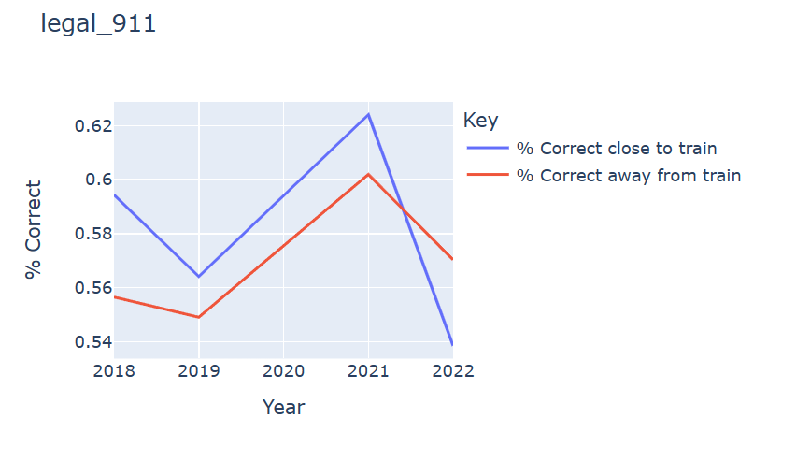
2
Is it legal to call 911 while stopped?
Notes:
*legal
Legal_911 = call 911 while driving

Slide 10
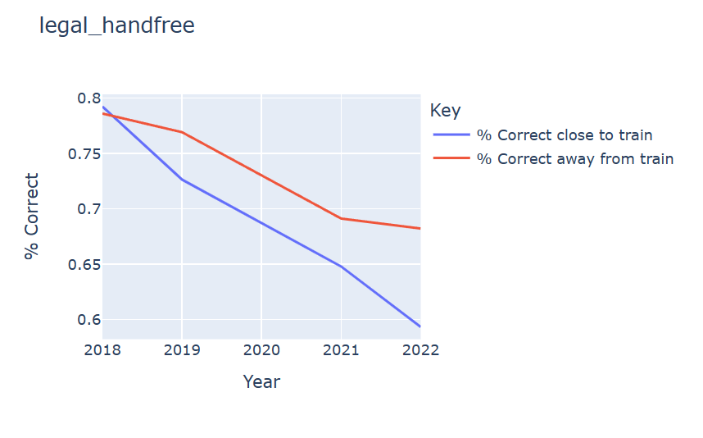
Is it to use a hands-free device?
Notes:
*legal
Legal_handfree = talk on a cell phone using hands-free device while driving

Slide 11
Conclusion
The data shows that generally, the residents living in zip codes closer to the Link Light Rail, have less knowledge regarding the new law put in place.
There does appear to be a correlation where the OVERALL awareness of the drivers decreases
COVID?

